Slide 1


Slide 2
PHP
PHP is an acronym for "PHP: Hypertext Preprocessor"
PHP is a widely-used, open source scripting language
It’s used in WordPress, Facebook
PHP scripts are executed efficiently on the server, and the result is returned to the browser
PHP files can contain text, HTML, CSS, JavaScript, and PHP code
PHP runs on various platforms (Windows, Linux, Mac), is compatible with most servers (Apache, IIS, etc.) and supports a wide range of databases
PHP is easy to learn

Slide 3
PHP
PHP can generate dynamic page content
PHP can create, open, read, write, delete, and close files on the server
PHP can collect form data
PHP can send and receive cookies
PHP can add, delete, modify data in your database
PHP can be used to control user-access
PHP can encrypt data
With PHP you can output HTML, images, PDF files, Flash movies, and any text, such as XHTML, XML and JSON.

Slide 4
Set Up PHP
Install a web server
Install PHP
Install a database, such as MySQL
e.g. XAMPP: https://www.apachefriends.org/index.html
NOTE:
Browsers do not read PHP.

Slide 5
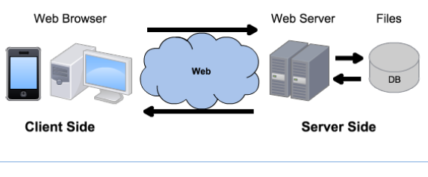
Architecture
HTML, CSS, JavaScript
HTTP
PHP, SQL, JSON

Slide 6
PHP Syntax
A PHP script can be placed anywhere in the document
The file will have a .php extension (not .html)
PHP statements end with a semicolon (;)
//, # single line comments
/* */ multi line comments
$variables a variable name cannot start with a number, and can only contain (A-z, 0-9, and _ )
all variable names are case-sensitive
keywords (e.g. if, else, while, echo, etc.), classes, functions, and user-defined functions are NOT case-sensitive.
<?php $txt = "W3Schools.com"; echo "I love $txt!"; // output to the client ?>
Notes:
Ex1.
It is usually good form to call functions, keywords, etc as they appear in their declaration.

Slide 7
PHP Scopes
A variable declared outside a function has a GLOBAL SCOPE and can only be accessed outside a function
A variable declared within a function has a LOCAL SCOPE and can only be accessed within that function
PHP also stores all global variables in an array called $GLOBALS[index] where index is the name of the variable. This array is accessible from within functions and can be used to update global variables directly.
When a function is completed, all of its variables are deleted.
If you need it for a further job, declare it as static:
$x = 1;
function myTest() { static $x = 0; echo $x + $GLOBALS['x'];
$x++; }
myTest(); // returns 1
myTest(); // returns 2
myTest(); // returns 3
Notes:
Ex 2

Slide 8
PHP Data Types
PHP is a Loosely Typed Language
String
strlen() function returns the length of a string
adding: "I love " . $txt . "!"; or "I love $txt!";
Integer
Float (double)
Boolean (true or false)
Array
Object
NULL (var created with no value or ‘emptied’)
var_dump() returns the data type and value
Notes:
Loosely Typed Language - meaning you don't have to specify what type of information will be stored in a variable in advance.

Slide 9
PHP Objects
<?php class Car { function Car() { // old-style constructor $this->model = "VW"; }
function __construct() { // the correct way
$this->model = "VW"; } } // create an object $herbie = new Car; // show object properties echo $herbie->model; ?>
Notes:
Ex3
__construct was introduced in PHP5 and it is the right way to define your constructors (in PHP4 you used the name of the class for a constructor).
You are not required to define a constructor in your class, but if you wish to pass any parameters on object construction then you need one.

Slide 10
PHP Constants
Constants
A constant is an identifier for an unchangeable value.
A constant name starts with A-z_ (no $ sign).
Constants are automatically global.
define(name, value, case-insensitive)
Default: false case-insensitive == case sensitive
<?php define("GREETING", "Welcome to W3Schools.com!"); echo GREETING; ?>
Notes:
Ex4

Slide 11
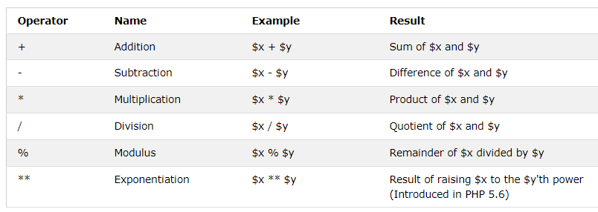
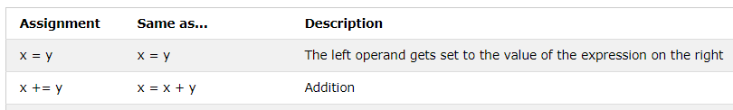
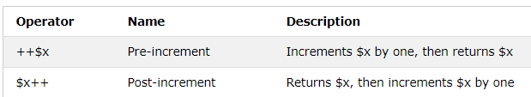
PHP Operators

Slide 12
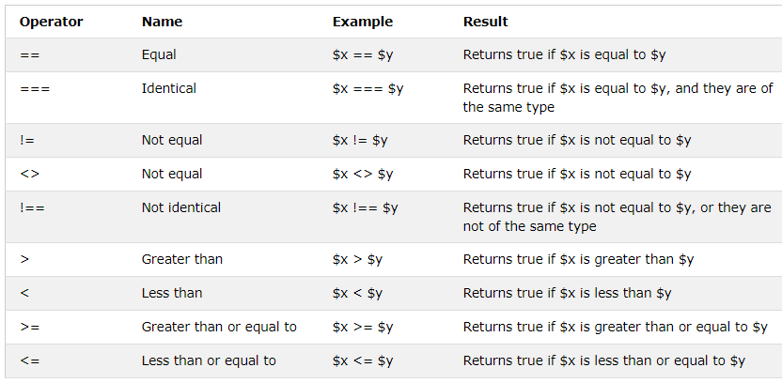
PHP Operators

Slide 13
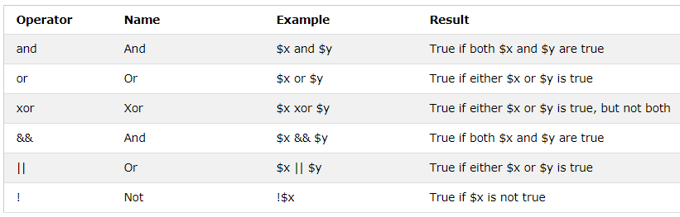
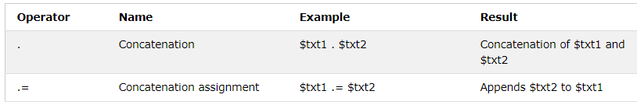
PHP Operators
Strings

Slide 14
PHP Functions
Functions
A function name starts with A-z_
Function names are NOT case-sensitive.
<?php function setHeight($minheight = 50) { return "The height is : $minheight "; } echo setHeight(350); echo setHEIGHT(); // will use the default value of 50
?>
Notes:
Ex5
It is usually good form to call functions as they appear in their declaration.

Slide 15
PHP Arrays
Indexed arrays:
$cars = array("Volvo", "BMW", "Toyota"); echo "I like " . $cars[0] . ", " . $cars[1] . " and " . $cars[2] . ".";
count() returns the length of an array
Associative arrays:
$age = array("Peter"=>"35", "Ben"=>"37", "Joe"=>"43");
$age['Peter'] = "35"; $age['Ben'] = "37"; $age['Joe'] = "43";
echo "Peter is " . $age['Peter'] . " years old.";
foreach($age as $x => $x_value) { echo "Key=" . $x . ", Value=" . $x_value . "<br>"; }
Sorting arrays: https://www.w3schools.com/php/php_arrays_sort.asp
Notes:
Ex6

Slide 16
PHP Superglobals
Superglobals are always accessible, from any function, class or file in the web application
$GLOBALS
$_GET: form and other data sent in the URL (VISIBLE)
up to 2000 chars, can be bookmarked
test_get.php?subject=PHP&web=W3schools.com
$module = $_GET['subject'];
$_POST: form data and hidden variables, embedded
<form method=“post”>
<input type=“text” name=“firstname”>
$fName = $_POST[firstname'];
$_REQUEST: form data
$_SESSION: to maintain state (HTTP is stateless), single user, until the browser is closed. For persistence --> DB
Notes:
Ex7 Ex8 Ex9
All associative arrays
$_GET – gets data sent with URL which is visible to user in address-bar of any web-browser, and any form data passed to the current script via the HTTP GET method.
$module = $_GET['subject'];
$fName = $_POST[firstname'];
There are security holes embedded within the code.
As a result, the URL can be manually modified (e.g., test_get.php?subject=<b>PHP</b>&web=W3schools.com). Use htmspecialchars($module, ENT_QUOTES, ‘UTF-8’) to prevent special HTML characters from being interpreted as HTML code by the browser.
$_POST - passed to the current script via the HTTP POST method. It is more secure than GET method.
$_REQUEST – any data appearing in either the $_POST or $_GET associative arrays.

Slide 17
PHP Sessions
<?php session_start(); // before any HTML ?> <!DOCTYPE html> <html> <body> <?php // Set session variables $_SESSION["favcolor"] = "green"; $_SESSION["favanimal"] = "cat"; echo "Session variables are set."; ?> </body> </html>
You can later access this information from any other page, as long as you use session_start() in it first, because sessions set a user-key on the user's computer.
When a session is opened on another page, it scans the computer for a user-key. If there is a match, it accesses that session, if not, it starts a new session.
To remove all global session variables and destroy the session, use session_unset() and session_destroy()
Notes:
Ex 10
Sessions allow you to store data on your web server for use on subsequent pages.
A PHP session sets a cookie in the user’s browsers that contains the session ID, and then sends that cookie along with every request for a page from your site.
Sessions typically are managed as temporary files stored on the web server, and can also be stored in your MYSQL database.

Slide 18
PHP Data Objects (PDO)
Interface for accessing databases in PHP.
PDO will work on 12 different database systems, whereas MySQLi will only work with MySQL databases.
So, if you need to use another database, PDO makes the process easy. You only have to change the connection string and a few queries.
You must use a database-specific PDO driver to access a database server.
On php.ini, the following line should be uncommented:
extension=php_pdo_mysql.dll
https://php.net/manual/en/pdo.installation.php

Slide 19
PHP + PDO + MySQL connect
<?php $servername = "localhost"; $username = "username"; $password = "password";
$dbname = "myDB"; try { $conn = new PDO("mysql:host=$servername;dbname=$dbname", $username, $password); // set the PDO error mode to exception $conn->setAttribute(PDO::ATTR_ERRMODE, PDO::ERRMODE_EXCEPTION); echo "Connected successfully"; } catch(PDOException $e){ echo "Connection failed: " . $e->getMessage(); } ?>
The connection will be closed automatically when the script ends.
To close the connection before, use $conn = null;
Notes:
Ex11
PHP automatically closes any open database connections once the script has finished running, so you can let it clean up from you.
Otherwise, use $conn = null.

Slide 20
PHP + PDO + MySQL insert
Syntax:
The SQL query must be quoted in PHP
$sql = "INSERT INTO MyGuests (firstname, lastname, numchildren) VALUES ('John', 'Doe', 3)";
String values inside the SQL query must be quoted
Numeric values must not be quoted
The word NULL must not be quoted
If a column is AUTO_INCREMENT (like the "id" column) or TIMESTAMP (like date columns), there is no need to specify it in the SQL query; MySQL will automatically add the value.
$sql2 = "INSERT INTO MyGuests (firstname, lastname, numchildren) VALUES (" . $_POST['fName'] . ", " . $_POST['lName'] . ", " . $_POST[‘children'] . ")"; // Do not use There is a serious problem with $sql2. The contents of the $_POST ['fName'] etc are enterd by users, and if a malicious user were to type nasty SQL code into the form, the script could feed it into the MySQL server. This type of attack is called an SQL injection attack.

Slide 21
Prepared Statements
A prepared statement is a feature used to execute the same (or similar) SQL statements repeatedly with high efficiency.
Prepare: An SQL statement template is created and sent to the database. Certain values are left unspecified, called placeholders / parameters Example: INSERT INTO myguests VALUES(?, ?, ?)
The database parses, compiles, and performs query optimization on the SQL statement template, and stores the result without executing it
Execute: At a later time, the application binds the values to the parameters, and the database executes the statement. The application may execute the statement as many times as it wants with different values

Slide 22
Prepared Statements
Compared to executing SQL statements directly, prepared statements have 3 main advantages:
Prepared statements reduces parsing time as the preparation on the query is done only once (although the statement is executed multiple times)
Bound parameters minimize bandwidth as you send only the parameters each time, and not the whole query
Prepared statements are very useful against SQL injections, because when later filling in placeholders / parameter values, PDO is smart enough to guard against “dangerous” characters automatically, i.e., if the original statement template is not derived from external input.

Slide 23
PHP + PDO + MySQL insert
$stmt = $conn->prepare("INSERT INTO myguests (firstname, lastname, email) VALUES (:firstname, :lastname, :email)"); $stmt->bindParam(':firstname', $firstname); $stmt->bindParam(':lastname', $lastname); $stmt->bindParam(':email', $email); // insert a row
$firstname = "John"; $lastname = "Doe"; $email = "john@example.com"; $stmt->execute();
// insert another row $firstname = "Mary"; $lastname = "Moe"; $email = "mary@example.com"; $stmt->execute();
// prepare once, execute multiple times
Notes:
Ex 12

Slide 24
PHP + PDO + MySQL transaction
// try block
try
{
$conn->beginTransaction();
$firstname = "John"; $lastname = "Doe"; $email = "john@example.com"; $stmt->execute();
$firstname = "Mary"; $lastname = "Moe"; $email = "mary@example.com"; $stmt->execute();
$conn->commit();
echo "New records created successfully"; } catch(PDOException $e) { $conn->rollback(); // roll back the transaction if something failed echo "Error: " . $e->getMessage(); }
Notes:
Ex13
beginTransaction - turns off autocommit mode, so that changes made to the database via PDO stay uncommitted until the transaction is neded by calling commit. Calling rollBack undoes all changes to the database and returns the connection to autocommit mode.

Slide 25
PHP + PDO + MySQL select
$stmt = $conn->query("SELECT id, firstname, lastname FROM myguests");
// include in a try block
// loop through
if ($stmt->rowCount() > 1)
{
echo 'Records Found<br>';
foreach ($stmt as $row)
{
echo $row['id'] . ' - ' . $row['firstname'] . ' ' . $row['lastname'] . '<br>';
}
}
else
{
echo 'No Records Found';
}
PDO::query is useful when you don’t need to:
Reuse sql statements.
Worry about sanitising sql statements (e.g., sqls not generated from user inputs)
Alternative
$stmt = $conn->prepare("SELECT id, firstname, lastname FROM myguests");
$stmt->execute();
Notes:
Ex14
// set the resulting array to associative $stmt->setFetchMode(PDO::FETCH_ASSOC);
// loop through
$stmt->fetchAll()

Slide 26
PHP + PDO + MySQL update
Notice the WHERE clause in the UPDATE syntax: The WHERE clause specifies which record or records that should be updated.
If you omit the WHERE clause, all records will be updated!
// Prepare statement
$stmt = $conn->prepare("UPDATE myguests SET lastname = :lName WHERE id = :id");
$stmt->bindParam(':lName', $lName);
$stmt->bindParam(':id', $id);
// execute the query // use a try block
$lName = 'Doe';
$id = 2; $stmt->execute();
// check if records updated
if ($stmt->rowCount() == 1)
{echo 'Record Updated'; }
else
{echo $stmt->rowCount() . ' records updated'; }
Notes:
Ex15

Slide 27
PHP + PDO + MySQL delete
Notice the WHERE clause in the DELETE syntax: The WHERE clause specifies which record or records that should be deleted.
If you omit the WHERE clause, all records will be deleted!
// sql to delete a record $sql = "DELETE FROM myguests WHERE id=2";
// use exec() when a result set isn’t returned and you don’t need to reuse an sql statement or worry about sanitising sql statements $conn->exec($sql);
Notes:
Ex16
Exec also works from CREATE TABLE statements

Slide 28
PHP Form Validation
The $_SERVER["PHP_SELF"] is a super global variable that returns the filename of the currently executing script. When used as the “form action”, $_SERVER["PHP_SELF"] will send the submitted form data to the page itself, instead of jumping to a different page, so that the user can get error messages on the same page as the form. However, $_SERVER["PHP_SELF"] can be used by hackers!
The htmlspecialchars() function converts special characters to HTML entities. It will replace HTML characters like < and > with &lt; and &gt;. This prevents attackers from exploiting the code by injecting HTML or Javascript code (Cross-site Scripting attacks) in forms.
Notes:
$_SERVER
Like $_GET and $_POST, $_SERVER is automatically created by PHP.
It stores a lot of information supplied by your web server.

Slide 29
Avoid Code Injection
If PHP_SELF is used in your page then a user can enter a slash (/) and then some Cross Site Scripting (XSS) commands to execute.
Assume we have the following form in a page named "test_form.php": <form method="post" action="<?php echo $_SERVER["PHP_SELF"];?>">
Now, if a user enters the normal URL in the address bar like "http://www.example.com/test_form.php", the above code will be translated to: <form method="post" action="test_form.php">
However, consider that a user enters the following URL in the address bar: http://www.example.com/test_form.php/%22%3E%3Cscript%3Ealert('hacked')%3C/script%3E
In this case, the above code will be translated to: <form method="post" action="test_form.php/"><script>alert('hacked')</script>
Notes:
Ex17

Slide 30
Avoid Code Injection
Recommendation, if using $_SERVER["PHP_SELF"]:
Use the htmlspecialchars() function
<form method="post" action="<?php echo htmlspecialchars($_SERVER["PHP_SELF"]);?>">
Transforms to:
<form method="post" action="test_form.php/&quot;&gt;&lt;script&gt;alert('hacked')&lt;/script&gt;">
Notes:
Ex18

Slide 31
Hiding the Seams
You can take any HTML web page, rename it with a .php file extention, and inject PHP code into it to generate page content on the fly.
Dynamic web pages
Website users do not need to know which site pages rely on PHP.
Eliminate filename extensions in your URLs to take advantage of directory indexes by having URLs pointing to directories on your web servers instead of specific files.
The web server will look for a file names index.html or index.php within the directory and display that file in response to the request.
E.g., using the previous example:
Create a subdirectory called test_form
Rename test_form.php to index.php and move to the test_form subdirectory
Now load http://localhost/test_form/ in your browser
Change the form element to: <form action="" method="post">
Notes:
Ex19

Slide 32
Sanitize the Input
The form variables sent by $_POST should also be sanitized:
function test_input($data) { $data = trim($data); $data = stripslashes($data); $data = htmlspecialchars($data); return $data; }
Notes:
Ex 20 – see next page

Slide 33
Form
<form method="post" action=""> <label for="name">Name:</label>
<input type="text" name="name"><br> <?php if (isset($formError['name'])) {echo '<span class="error">*' . $formError['name'] . '</span><br>'; } ?>
<label for="email">Email:</label>
<input type="text" name="email"><br>
<?php if (isset($formError['email'])) {echo '<span class="error">*' . $formError['email'] . '</span><br>'; } ?>
<input type="submit" name="submit" value="Go"> </form>
Notes:
Ex 20 – see next page

Slide 34
Validation
$formError = [];
$name = $email = "";
if ($_SERVER["REQUEST_METHOD"] == "POST") { //check if submitted if (empty($_POST["name"])) { $formError['name'] = "Name is required"; } else { $name = test_input($_POST["name"]);
if (!preg_match("/^[a-zA-Z ]*$/",$name))
$formError['name'] = "Only letters and spaces allowed"; } if (empty($_POST["email"])) { $formError['email'] = "Email is required"; } else { $email = test_input($_POST["email"]);
if (!filter_var($email, FILTER_VALIDATE_EMAIL))
$formError['email'] = "Invalid email format"; }
}
if (empty($formError)) {
echo "Hello $name";
}
Notes:
Ex 20 – run
Use
if ($_SERVER["REQUEST_METHOD"] == "POST")
OR
if (isset($_POST['submit']) && $_POST['submit'] === 'Go')

Slide 35
Filters
Sanitizing data = Remove any illegal characters
Validating data = Determine if the data is in proper form
The filter_var() function can do both, with:
The variable you want to check
The type of check to use (sanitize or validate and type)
FILTER_SANITIZE_STRING removes HTML tags from a string, and returns the new string
FILTER_SANITIZE_EMAIL removes all illegal characters from email, and returns the new email string
FILTER_SANITIZE_URL removes all illegal characters from url, and returns the new url string
FILTER_VALIDATE_INT (>0), FILTER_VALIDATE_EMAIL, FILTER_VALIDATE_URL return a Boolean
https://www.w3schools.com/php/php_ref_filter.asp

